Slide 1

HolMUSK NLP Challenge Junior Data Scientist (NLP)
Candidate
Aye Hninn Khine
ayehninnkhine93@gmail.com

Slide 2
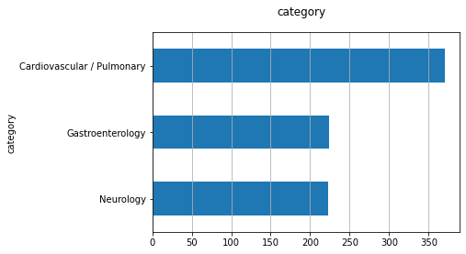
NLP Challenge
Given:
Medical Notes collected from patient visits
“ClinNotes.csv” contains notes (column=’notes’) from three departments (column=’category’) - Cardiovascular / Pulmonary, Neurology, and Gastroenterology

Slide 3
NLP Challenge
A list of related medical entities pairs
“MedicalConcepts.csv” contains a list of related medical entities pairs (Term1 and Term2 are related to each other) that has been curated by domain experts
566 medical term pairs

Slide 4
NLP Challenge
Task:
To propose different approaches to generate vector representations of texts
To assess and compare the suitability of the approach for this dataset

Slide 5
Experiment Design
Word Representation Method
Clinical Notes
Medical Concept
Extrinsic Evaluation
(Category Classification)
Intrinsic Evaluation
(Word Pair Similarity)

Slide 6
Technical Stacks
Pandas (Data Analysis/Data Frame)
Matplotlib (Data Visualization)
Keras (Deep Learning)
NLTK (NLP)
Gensim (Word Embedding)
Sklearn (Machine Learning, NLP, Evaluation)

Slide 7
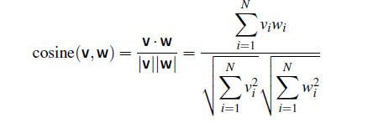
Intrinsic Evaluation
Term 1 | Term 2
Glaucoma | Fibrillation
Carbatrol | Dilantin
Cardiomyopathy | Tylenol
Herpes | Hyperthyroidism
Word Similarity (Semantic Relatedness)
Cosine Similarity (Dot product of the word vectors)

Slide 8
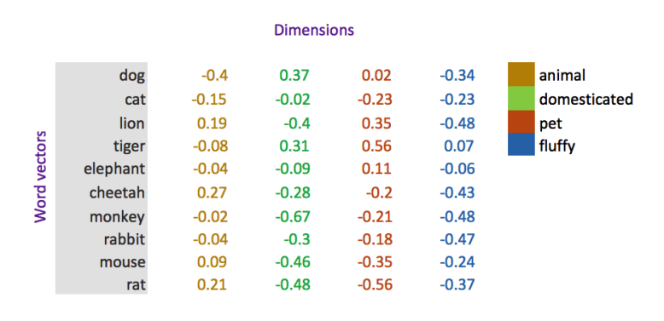
Word Embedding
Word Vector Representation Method
A short dense vector (dimension 50-1000) representation derived from the distribution of word neighbors

Slide 9
Word Embedding Sets
Word Embedding | Dimension | Training Corpus | # of Vocabulary
W2V(Google-News) | 300 | Google News | 3,000,000
W2V (ClinNotes) | 300 | Clinical Notes | 8,973
W2V(Wiki-Pubmed-PMC) | 200 | Wikipedia PubMed articles | 5,443,656
W2V(BioW2V) | 200 | PubMed MIMIC-III | 16,545,452
W2V(stanford_cuis) | 300 | Claims Dataset | 22,705
W2V(DeVine_etal) | 200 | Medical Journal Abstracts | 52,102

Slide 10
Vocabulary Coverage (Intrinsic Evaluation)
X-axis – number of missing vocabularies

Slide 11
Intrinsic Evaluation (Word Pair Similarity)
(X-axis – number of medical term pairs)

Slide 12
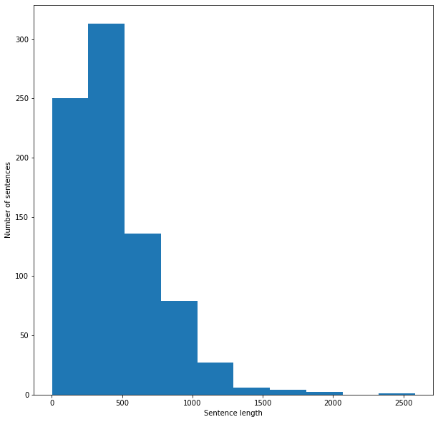
Extrinsic Evaluation (Medical Category Classification)
Splitting the dataset (Train/Test – 80:20)
Preprocessing the clinic notes
Total words = 371028
Vocabulary size = 13626
Maximum sentence length = 2583

Slide 13
Extrinsic Evaluation (Clinical Notes Category Classification) Logistic Regression Classification
Averaging word2vec as feature extraction

Slide 14
Extrinsic Evaluation (Clinical Notes Category Classification) CNN Classification

Slide 15
Retrofitting Word Vector
Traditional Word Vector
Retrofitting Word Vectors – refining word vector representations using external knowledge (usually semantic lexicon, sentiment lexicon) by encouraging linked words to have similar vector representation
Paper: https://arxiv.org/abs/1411.4166
Medical Concept
Word Vector Refinement Method
Retrofitted Word Vector

Slide 16
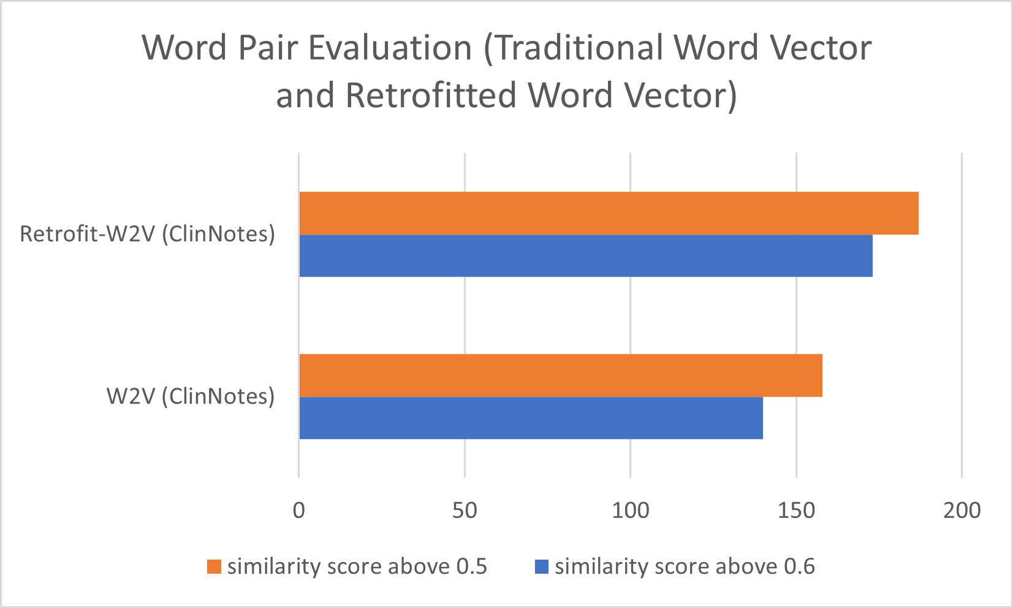
Intrinsic Evaluation (Retrofit Word Vectors)

Slide 17
Extrinsic Evaluation (Retrofit Word Vectors) Logistic Regression

Slide 18
Conclusions
Word2Vec models trained on a large domain-specific corpus reported the best performances in both intrinsic and extrinsic evaluation.
Word2Vec trained on a small domain-specific corpus outperformed large general word2vec models in intrinsic evaluation.
Retrofitting can improve the performance of a word2vec model in intrinsic evaluation but not in extrinsic evaluation.
Logistic regression significantly outperformed CNN in clinic notes classification. I assume that word2vec models have lower vocabulary coverage to use as a look-up layer in deep learning models.
My recommendation is to use the domain-specific word embedding models trained on a large medical corpus in generating vector representation of text for intrinsic and extrinsic tasks.

Slide 19
References
https://github.com/clinicalml/embeddings
https://github.com/ncbi-nlp/BioSentVec
https://github.com/mfaruqui/retrofitting
https://arxiv.org/abs/1408.5882
https://aclanthology.org/N18-2031/
https://arxiv.org/abs/1411.4166

